Slide 1

PRESENTATION ON
JINI TECHNOLOGY
By GAUTAM SUTHAR , CSE PRE FINAL YEAR UNDERGRAD ,FULL STACK DEVELOPER , NATIVE SPANISH SPEAKER

Slide 2
CONTENT
Introduction
History
Architecture
Working
Objective
Goals
Component
Benefits
Limitations
Conclusion

Slide 3
WHAT IS JINI TECHNOLOGY
APPLICATIONS
SIMPLE
INFRASTRUCTURE
DATABASE
PRINTING
STORAGE

Slide 4
HISTORY OF JINI TECHNOLOGY
The idea of the jini system was invented by bill joy at SUN ASOEN SMALL WORKS R&D LAB IN 1994
Jini was introduced in July 1998 by Sun Microsystems.
Jini is implemented in the Java programming language.
The Word “jini” means “the devil” which is the origin of the english word “genie” or in spanish as “el diable”.
On January 25 , 1999 Jini was officially launched and the technology is open sourced.

Slide 5
ARCHITECTURE OF JINI
The user who accesses the resources shared over a network
Services for resources such as printers, storage devices and speakers, which are attached to the server and made available to clients over the network
The system to which the resources are attached
CLIENT
LOOKUP SERVICE
SERVER

Slide 6
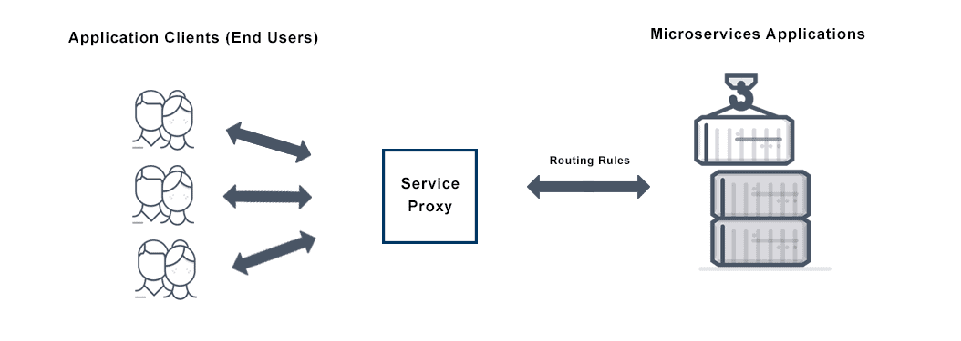
SERVICE PROXY
Service proxy is a client-side proxy for microservices applications that allows the application components to send and receive traffic.
The main job of a service proxy is to ensure traffic is routed to the right destination service or container and to apply security policies.

Slide 7
HOW JINI WORKS ?
SERVICE
NETWORK
LOOKUP
SERVICE
SERVICE
PROXY
SERVICE
PROXY
CLIENT
NETWORK

Slide 8
OBJECTIVE OF JINI TECHNOLOGY
SHIFTING THE FOCUS
DISK
DRIVE
ORIENTED
APPROACH
NETWORK
ADDAPTIVE
APPROACH
SCALABLE
EVOLVABLE
FLEXIBLE
DYNAMIC
COMPUTING
ENVIRONMENT

Slide 9
COMPONENTS OF JINI TECH
SERVICES
LOOKUP-SERVICES
EXTENDED RMI
JAVA SPACES
DISTRIBUTED SECURITY
DISTRIBUTED EVENTS
TRANSACTIONS

Slide 10
GOALS OF JINI TECHNOLOGY
To enable users to share services and resources over a network.
To provide users the ability to access resources anywhere easily on the network , even though the network location of the user may constantly change.
To simplify the task of creating and managing network devices , software services , users.
Jini makes resources over a network look like local resources.

Slide 11
BENEFITS OF JINI TECHNOLOGY
It is easy to add and remove services.
Services can be relocated on the network without affecting users.
JINI is open-source , meaning that the program code is freely available on the Internet and there is no fees for using it.
The JINI architecture is scalable.
Everyone can access to same information & resources.

Slide 12
LIMITATIONS OF JINI TECHNOLOGY
Depends on java / RMI or external mechanism for security.
Does not scale well to very large systems because jini use lookup service as a broker between client & services

Slide 13
CURRENT SCENARIO / conclusion
jini.org not available
Source code is not available
APACHE RIVER to ATTIC
Eg : WINDOWS 365 , Cloud Gaming etc

Slide 14
Thanks for Your
Kind Attention

